Slide 1



Python 3 Beginner
Chapter 00
Previously, on Python 3 Beginner…
release 1.0.0
37/39 Avenue Ledru Rollin – CS 11237 – 75750 PARIS CEDEX 12 - info@valnaos.com – www.valnaos.com Tél : 01 86 95 20 48

Slide 2

Cloud Technology Associate
Copyright © 2018 | 9
Q&A
37/39 Avenue Ledru Rollin – CS 11237 – 75750 PARIS CEDEX 12 - info@valnaos.com – www.valnaos.com Tél : 01 86 95 20 48

Slide 3

Where? Who?
Python 3 Beginner
Class Material
GitHub: https://github.com/cstar-industries/python-3-beginner
Instructor
Charles Francoise <charles@cstar.io>

Slide 4
Python 3 Beginner
Chapter 01
HTTP with Requests
release 1.0.0
37/39 Avenue Ledru Rollin – CS 11237 – 75750 PARIS CEDEX 12 - info@valnaos.com – www.valnaos.com Tél : 01 86 95 20 48

Slide 5
Requests
Python 3 Beginner
Requests is a library that makes HTTP requests very simple, while still providing powerful in-depth options
"HTTP for Humans"
Perfect for downloading/uploading data, or communicating with a web service API

Slide 6
Requests
Python 3 Beginner
HTTP in a nutshell
GET / HTTP/1.1
Accept: */*
Accept-Encoding: gzip, deflate
Connection: keep-alive
Host: www.google.com
User-Agent: HTTPie/1.0.2
HTTP/1.1 200 OK
Cache-Control: private, max-age=0
Content-Encoding: gzip
Content-Type: text/html; charset=ISO-8859-1
Date: Tue, 12 May 2020 08:34:48 GMT
Expires: -1
Server: gws
Set-Cookie: 1P_JAR=2020-05-12-08; expires=Thu, 11-Jun-2020 08:34:48 GMT; path=/; domain=.google.com; Secure
Transfer-Encoding: chunked
<!doctype html><html itemscope="" itemtype="http://schema.org/WebPage" lang="fr"><head> <meta content="text/html; charset=UTF-8" http-equiv="Content-Type"><meta content="/images/branding/googleg/1x/googleg_standard_color_128dp.png" itemprop="image"><title>Google</title>...

Slide 7
Requests
Python 3 Beginner
requests.get sends a GET request
Returns a Response object with info about the data
res = requests.get('https://google.com')
print(res.ok)
print(res.status_code)
print(res.reason)
print(res.elapsed)
True
200
OK
0:00:00.085902

Slide 8
Requests
Python 3 Beginner
The response content is available in several forms
type(res.text)
type(res.content)
str
bytes
Parse a JSON response directly to a dict
type(res.json())
dict

Slide 9
Requests
Python 3 Beginner
Read the response headers in dict form
print(res.headers)
{'Date': 'Tue, 12 May 2020 10:00:57 GMT',
'Expires': '-1',
'Cache-Control': 'private, max-age=0',
'Content-Type': 'text/html; charset=ISO-8859-1
...
Parse a JSON response directly to a dict
type(res.json())
dict

Slide 10
Requests
Python 3 Beginner
Raise a Python error on HTTP errors
res = requests.get('https://google.com/toto')
print(res.ok)
print(f'{res.status_code} {res.reason}')
res.raise_for_status()
False
404 Not Found
HTTPError: 404 Client Error: Not Found for url: https://google.com/toto
Other HTTP methods are available
res = requests.post('https://httpbin.org/post', data=...
res = requests.put('https://httpbin.org/post', data=...
res = requests.delete(...
res = requests.head(...
res = requests.request('GET', 'https://...

Slide 11
Requests
Python 3 Beginner
Send query variables with params
res = requests.get('https://www.google.com/search',
params={'q':'Hello World'})
print(res.url)
https://www.google.com/search?q=Hello+World
Send data in request body with data
res = requests.post('https://httpbin.org/post',
data=b'Hello World!')
res = requests.post('https://httpbin.org/post',
data={'hello': 'world', 'search': 'python'})
print(res.request.body)
hello=world&search=python

Slide 12
Requests
Python 3 Beginner
Encode request data as JSON
res = requests.post('https://httpbin.org/post',
json={'hello': 'world', 'python': None})
print(res.request.body)
b'{"hello": "world", "python": null}'
Send file attachments
with open('profile_pic.png', 'rb') as f:
res = requests.post('https://httpbin.org/post',
files={'upload': f})
len(res.request.body)
669525

Slide 13
Requests
Python 3 Beginner
Customize request headers
res = requests.get('https://httpbin.org/post',
headers={'Authorization': 'alibaba:opensesame'})
print(res.request.body)
b'{"hello": "world", "python": null}'
Set request timeout
res = requests.get('https://www.google.com', timeout=0.001)
ConnectTimeout: 'Connection to www.google.com timed out. (connect timeout=0.001)'))

Slide 14
Python 3 Beginner
Chapter 02
Web Applications with Flask
release 1.0.0
37/39 Avenue Ledru Rollin – CS 11237 – 75750 PARIS CEDEX 12 - info@valnaos.com – www.valnaos.com Tél : 01 86 95 20 48

Slide 15
Flask
Python 3 Beginner
Flask is a micro-framework for building web applications
Use Flask to build web servers simply and efficiently without worrying about low-level details
Flask is perfect to build web applications with a JSON-based REST API
Use Flask wherever you would use PHP, Node.js or other non-Python backend technology

Slide 16
Requests
Python 3 Beginner
from flask import Flask
Write a simple Flask server
app = Flask(__name__)
@app.route('/')
def index():
return 'Hello World!'
Run the server with the Flask CLI
FLASK_APP=main.py flask run
* Serving Flask app "main.py"
* Running on http://127.0.0.1:5000/ (Press CTRL+C to quit)

Slide 17
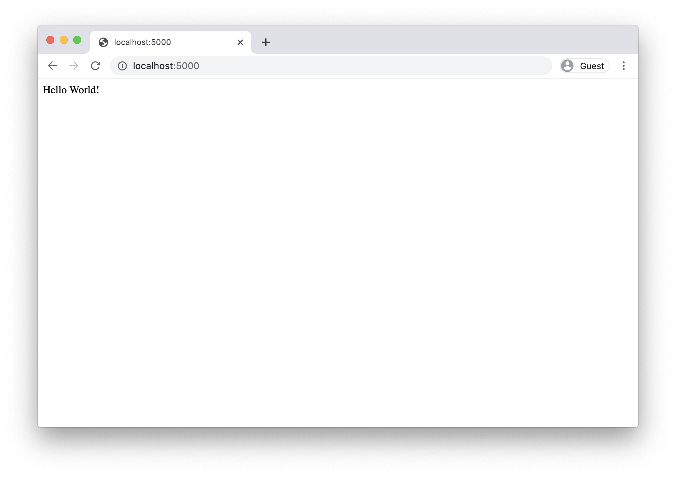
Flask
Python 3 Beginner
127.0.0.1 - - [12/May/2020 17:35:32] "GET / HTTP/1.1" 200 -
127.0.0.1 - - [12/May/2020 17:35:32] "GET /favicon.ico HTTP/1.1" 404 -

Slide 18
Requests
Python 3 Beginner
Run Flask in debug mode:
Extra info in response on errors
Automatic reload whan a file changes
FLASK_ENV=development FLASK_APP=main.py flask run
By default, only GET is supported by your route definitions
Use methods argument in the decorator
@app.route('/', methods=['GET', 'POST'])
def index():
return 'Hello World!'

Slide 19
Requests
Python 3 Beginner
Run Flask in debug mode:
Extra info in response on errors
Automatic reload whan a file changes
FLASK_ENV=development FLASK_APP=main.py flask run
By default, only GET is supported by your route definitions
Use methods argument in the decorator
@app.route('/', methods=['GET', 'POST'])
def index():
return 'Hello World!'

Slide 20
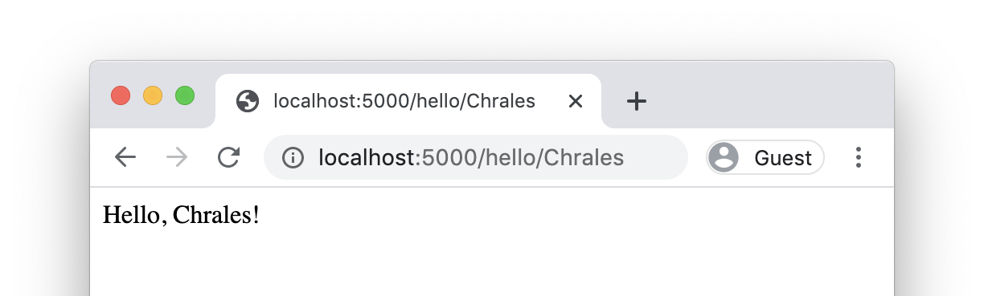
Requests: Defining routes
Python 3 Beginner
Define more routes with the route decorator
@app.route('/hello')
def hello():
return '<html><body>Hello</body></html>'
Capture variables from the address
@app.route('/hello/<name>')
def hello(name):
return f'<html><body>Hello, {name}!</body></html>'

Slide 21
Requests: Retrieving data from request
Python 3 Beginner
from flask import Flask, request
To access parameters submitted in the URL (?key=value), use the args attribute:
@app.route('/search')
def hello():
search_params = request.args.get('q')
return f'No results found for "{q}".'

Slide 22
Requests: Retrieving data from request
Python 3 Beginner
The raw request body can be read inside the handler
req_body = request.data
Request data can be parsed automatically
request.form # Form-encoded request data, parsed to a dict
request.json # JSON-encoded request data, parsed to a dict
request.files # A dict of files from multipart form-encoded data
request.headers # A dict of headers from the client request
request.cookies # A dict of cookies from the client request
...

Slide 23
Requests: Customizing the response
Python 3 Beginner
The raw request body can be read inside the handler
req_body = request.data
Request data can be parsed automatically
request.form # Form-encoded request data, parsed to a dict
request.json # JSON-encoded request data, parsed to a dict
request.files # A dict of files from multipart form-encoded data
request.headers # A dict of headers from the client request
request.cookies # A dict of cookies from the client request
...

Slide 24
Python 3 Beginner
Chapter 03
Manipulating images with Pillow
release 1.0.0
37/39 Avenue Ledru Rollin – CS 11237 – 75750 PARIS CEDEX 12 - info@valnaos.com – www.valnaos.com Tél : 01 86 95 20 48

Slide 25
Pillow
Python 3 Beginner
Pillow is a powerful library for opening, manipulating and creating all types of image files
Open-source fork of a historical Python library: PIL
Opens all types of images including JPEG, PNG, TIFF, BMP, TGA, PDF...
Allows geometrical transformations, pixel manipulation, channel operations, drawing, writing text...

Slide 26
Pillow: Opening an image file
Python 3 Beginner
from PIL import Image
Open an existing file with Image.open
img = Image.open('flag.png')
img.show()
Get information on the file
print(f'{img.format} {img.mode} {img.size}')
PNG RGB (128, 128)

Slide 27
Pillow: Geometrical transformations
Python 3 Beginner
Rotating
img = img.rotate(45, fillcolor=(255, 255, 255))
Scaling
img = img.resize((256, 128))

Slide 28
Pillow: More tranformations
Python 3 Beginner
Blur
img = img.filter(ImageFilter.BLUR)
Crop
img = img.crop((128, 0, 256, 128))

Slide 29
Pillow: Saving a file to disk
Python 3 Beginner
Converting mode
img = img.convert('L')
Save an image with save
Image format is chosen from extension
img.save('broken-flag.jpg')

Slide 30
Pillow: Create a new image
Python 3 Beginner
img = Image.new('RGB', (128, 128))
Access pixel data with load
Pixels are tuples with 1, 3 or 4 values (depending on the mode)
px = img.load()
print(px[64, 64])
(0, 0, 0)

Slide 31
Pillow: Pixel modification
Python 3 Beginner
PixelAccess is mutable
for x in img.width:
for y in img.height:
if (y % 3) == 0:
px[x, y] = (255, 255, 255)

Slide 32
Python 3 Beginner
Chapter 04
Math with Numpy
release 1.0.0
37/39 Avenue Ledru Rollin – CS 11237 – 75750 PARIS CEDEX 12 - info@valnaos.com – www.valnaos.com Tél : 01 86 95 20 48

Slide 33
Numpy
Python 3 Beginner
Numpy is an advanced mathematics library
Offers a powerful multi-dimensional array type, and advanced numeric types
Basic math functionality, random number generation, linear algebra, statistics, Fourier transform...
Powerful broadcasting algorithms for performing math over large arrays
Advantageously replaces MATLAB in most situations

Slide 34
Numpy
Python 3 Beginner
import numpy as np
Numpy offers basic math constants and functions
print(np.pi)
print(np.e)
print(np.sqrt(2))
print(np.cos(np.pi))
print(np.log(2))
3.141592653589793
2.718281828459045
1.4142135623730951
-1.0
0.6931471805599453

Slide 35
Numpy
Python 3 Beginner
The array class is the heart of Numpy
a = np.array([1, 2, 3, 4, 5])
print(a)
[1 2 3 4 5]
print(a.dtype) # datatype
print(a.size) # number of elements
print(a.ndim) # number of dimensions
print(a.shape) # length of the array in each dimension
int64
5
1
(5,)

Slide 36
Numpy
Python 3 Beginner
The array class is the heart of Numpy
a = np.array([1, 2, 3, 4, 5])
print(a)
[1 2 3 4 5]
print(a.dtype) # datatype
print(a.size) # number of elements
print(a.ndim) # number of dimensions
print(a.shape) # length of the array in each dimension
int64
5
1
(5,)

Slide 37
Numpy
Python 3 Beginner
arrays can be 2-dimensional (or more!)
many available datatypes
a = np.array([[1, 2, 3], [4, 5, 6]], dtype=np.float)
[[1. 2. 3.]
[4. 5. 6.]]
print(a.dtype) # datatype
print(a.size) # number of elements
print(a.ndim) # number of dimensions
print(a.shape) # length of the array in each dimension
float64
6
2
(2, 3)

Slide 38
Numpy
Python 3 Beginner
Many array creation facilities exist
np.zeros((3, 3)) # 3x3 zero-filled array
np.ones((3, 3)) # 3x3 one-filled array
np.eye(3) # 3x3 identity matrix (ones in the main diagonal)
np.random.random(size=(3, 3))
# 3x3 matrix of random 0 <= n < 1 values
Change arrays without changing content
a = np.arange(4) # array([0, 1, 2, 3])
print(a.shape, a.size, a.dtype)
b = a.reshape((2, 2)).astype(np.float)
print(b)
(4,) 4 int64
[[0. 1.]
[2. 3.]]

Slide 39
Numpy
Python 3 Beginner
Perform array/matrix mathematics
a = np.array([[0., 1.], [2., 3.]])
b = np.array([[0., 2.], [-1. ,0.]])
Add a scalar
print(a + 3.0)
[[3. 4.]
[5. 6.]]
Multiply by a scalar
print(a * 3.0)
[[0. 3.]
[6. 9.]]

Slide 40
Numpy
Python 3 Beginner
Add arrays together
print(a + b)
[[0. 3.]
[1. 3.]]
Element-wise multiplication
print(a * b)
[[ 0. 2.]
[-2. 0.]]
Matrix product
print(a.dot(b)) # == a @ b
[[-1. 0.]
[-3. 4.]]

Slide 41
Numpy
Python 3 Beginner
Broadcast functions over arrays
print(np.sqrt(a))
[[0. 1. ]
[1.41421356 1.73205081]]
Various operations
print(a.min(), a.max(), a.mean(), a.std())
print(a.sum(), a.prod())
print(a.sum(axis=0))
print(a.flatten())
0.0 3.0 1.5 1.118033988749895
6.0 0.0
[2. 4.]
[0., 1., 2., 3.]

Slide 42
Numpy
Python 3 Beginner
Get eigenvalues and eigenvectors
w, v = np.linalg.eig(np.array([[0., 1.], [1., 0.]]))
[ 1. -1.]
[[ 0.70710678 -0.70710678]
[ 0.70710678 0.70710678]]
Solve equation sets
x = np.array([[3., 2.], [1., 1.]])
y = np.array([3., 0.])
np.linalg.solve(x, y)
array([ 3., -3.])

Slide 43
Python 3 Beginner
Chapter 05
Visualizing data with Matplotlib
release 1.0.0
37/39 Avenue Ledru Rollin – CS 11237 – 75750 PARIS CEDEX 12 - info@valnaos.com – www.valnaos.com Tél : 01 86 95 20 48

Slide 44
Matplotlib
Python 3 Beginner
Matplotlib is the reference graphing and data visualization library for Python data science
It is most often used with the stateful matplotlib.pyplot module
Similar to MATLAB
Pyplot is based on creating figures and plotting data inside those figures

Slide 45
Matplotlib
Python 3 Beginner
import matplotlib.pyplot as plt
Plot the function y = x2 for x in [-2, 2]
x = np.linspace(-2, 2, 100)
y = x * x
plt.plot(x, y)
plt.show()

Slide 46
Matplotlib
Python 3 Beginner
Plot several series and add a legend
y0 = x * x
y1 = -2 * x * x + 1
plt.plot(x, y0)
plt.plot(x, y1)
plt.legend(['$x^2$', '$2-x^2+1$'])
plt.show()

Slide 47
Matplotlib
Python 3 Beginner
Draw heatmaps and surfaces
plt.figure(figsize=(16, 6))
plt.subplot(1, 2, 1)
plt.imshow(z, cmap='gray', extent=[-10, 10, -10, 10])
ax = plt.subplot(1, 2, 2, projection='3d')
ax.plot_surface(xv, yv, z, cmap='terrain')
plt.show()

Slide 48
Python 3 Beginner
Chapter 06
Handling data sets with Pandas
release 1.0.0
37/39 Avenue Ledru Rollin – CS 11237 – 75750 PARIS CEDEX 12 - info@valnaos.com – www.valnaos.com Tél : 01 86 95 20 48

Slide 49
Pandas
Python 3 Beginner
Pandas is a library to handle, prepare and process data sets
Reads many data formats like Excel, CSV, HDF5, Feather, SQLite...
Handle row-based or column-based data in the form of series and dataframes
"Excel for Python"
Often the first step to data exploration and analysis

Slide 50
Pandas
Python 3 Beginner
import pandas as pd
Data comes in series
Series can be imported from files or created from scratch
Series are indexed
s = pd.Series([6., 5., 6., 3.])
print(s)
0 6.0
1 5.0
2 6.0
3 3.0
dtype: float64

Slide 51
Pandas
Python 3 Beginner
A collection of series with a shared index is a data frame
Similar to a database table or a spreadsheet
df = pd.DataFrame(np.random.random((6, 4)),
columns=['Col1', 'Col2', 'Col3', 'Col4'])
print(df)
Col1 Col2 Col3 Col4
0 0.979237 0.982279 0.562715 0.773005
1 0.502712 0.953881 0.720175 0.529885
2 0.138129 0.186640 0.471914 0.458796
3 0.536048 0.258074 0.004619 0.305234
4 0.577828 0.004287 0.095598 0.217330
5 0.665738 0.605397 0.219344 0.766313

Slide 52
Pandas
Python 3 Beginner
A column or a row of a data frame is a series
Columns can be referenced by name, rows by index with loc
print(df['Col1'])
print(df.loc[0])
0 0.979237 Col1 0.979237
1 0.502712 Col2 0.982279
2 0.138129 Col3 0.562715
3 0.536048 Col4 0.773005
4 0.577828 Name: 0, dtype: float64
5 0.665738
Name: Col1, dtype: float64

Slide 53
Pandas
Python 3 Beginner
Get sub-dataframes with indexing
print(df[['Col2','Col3']])
print(df[1:-1])
Col2 Col3 Col1 Col2 Col3 Col4
0 0.982279 0.562715 1 0.502712 0.953881 0.720175 0.529885
1 0.953881 0.720175 2 0.138129 0.186640 0.471914 0.458796
2 0.186640 0.471914 3 0.536048 0.258074 0.004619 0.305234
3 0.258074 0.004619 4 0.577828 0.004287 0.095598 0.217330
Add a column by label (like dict)
df['Names'] = ['Alice', 'Bob', 'Charlie', 'Daniel', 'Eve', 'Fiona']
Col1 Col2 Col3 Col4 Names
0 0.979237 0.982279 0.562715 0.773005 Alice
1 0.502712 0.953881 0.720175 0.529885 Bob
2 0.138129 0.186640 0.471914 0.458796 Charlie

Slide 54
Pandas
Python 3 Beginner
Read a data file into a dataframe
df = pd.read_csv('tesla-stock-price.csv')
df.head()
date close volume open high low
0 2018/10/15 259.59 6189026.0 259.06 263.28 254.5367
1 2018/10/12 258.78 7189257.0 261.00 261.99 252.0100
2 2018/10/11 252.23 8128184.0 257.53 262.25 249.0300
3 2018/10/10 256.88 12781560.0 264.61 265.51 247.7700
4 2018/10/09 262.80 12037780.0 255.25 266.77 253.3000

Slide 55
Pandas
Python 3 Beginner
Edit index and columns
df = df.set_index(pd.DatetimeIndex(df['date'])) # Use date col as index
df = df.loc[:, df.columns != 'date'] # Drop date col
df.head()
close volume open high low
date
2018-10-15 259.59 6189026.0 259.06 263.28 254.5367
2018-10-12 258.78 7189257.0 261.00 261.99 252.0100
2018-10-11 252.23 8128184.0 257.53 262.25 249.0300
2018-10-10 256.88 12781560.0 264.61 265.51 247.7700
2018-10-09 262.80 12037780.0 255.25 266.77 253.3000

Slide 56
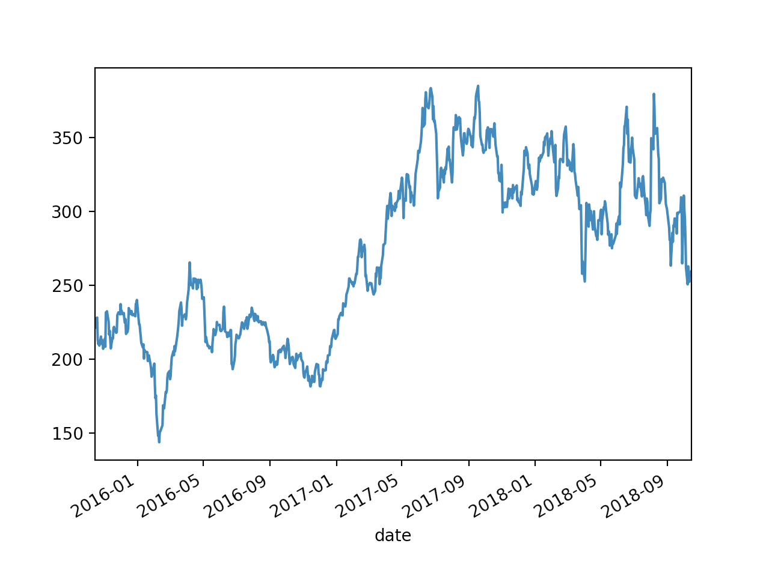
Pandas
Python 3 Beginner
Interact with other data science libraries
a = df.to_numpy()
type(a)
print(a.shape)
numpy.ndarray
(756, 5)
df['close'].plot()

Slide 57
Cloud Technology Associate
Copyright © 2018 | 9
Q&A
37/39 Avenue Ledru Rollin – CS 11237 – 75750 PARIS CEDEX 12 - info@valnaos.com – www.valnaos.com Tél : 01 86 95 20 48

Slide 58
Thank you for your attention!

